Slide 1
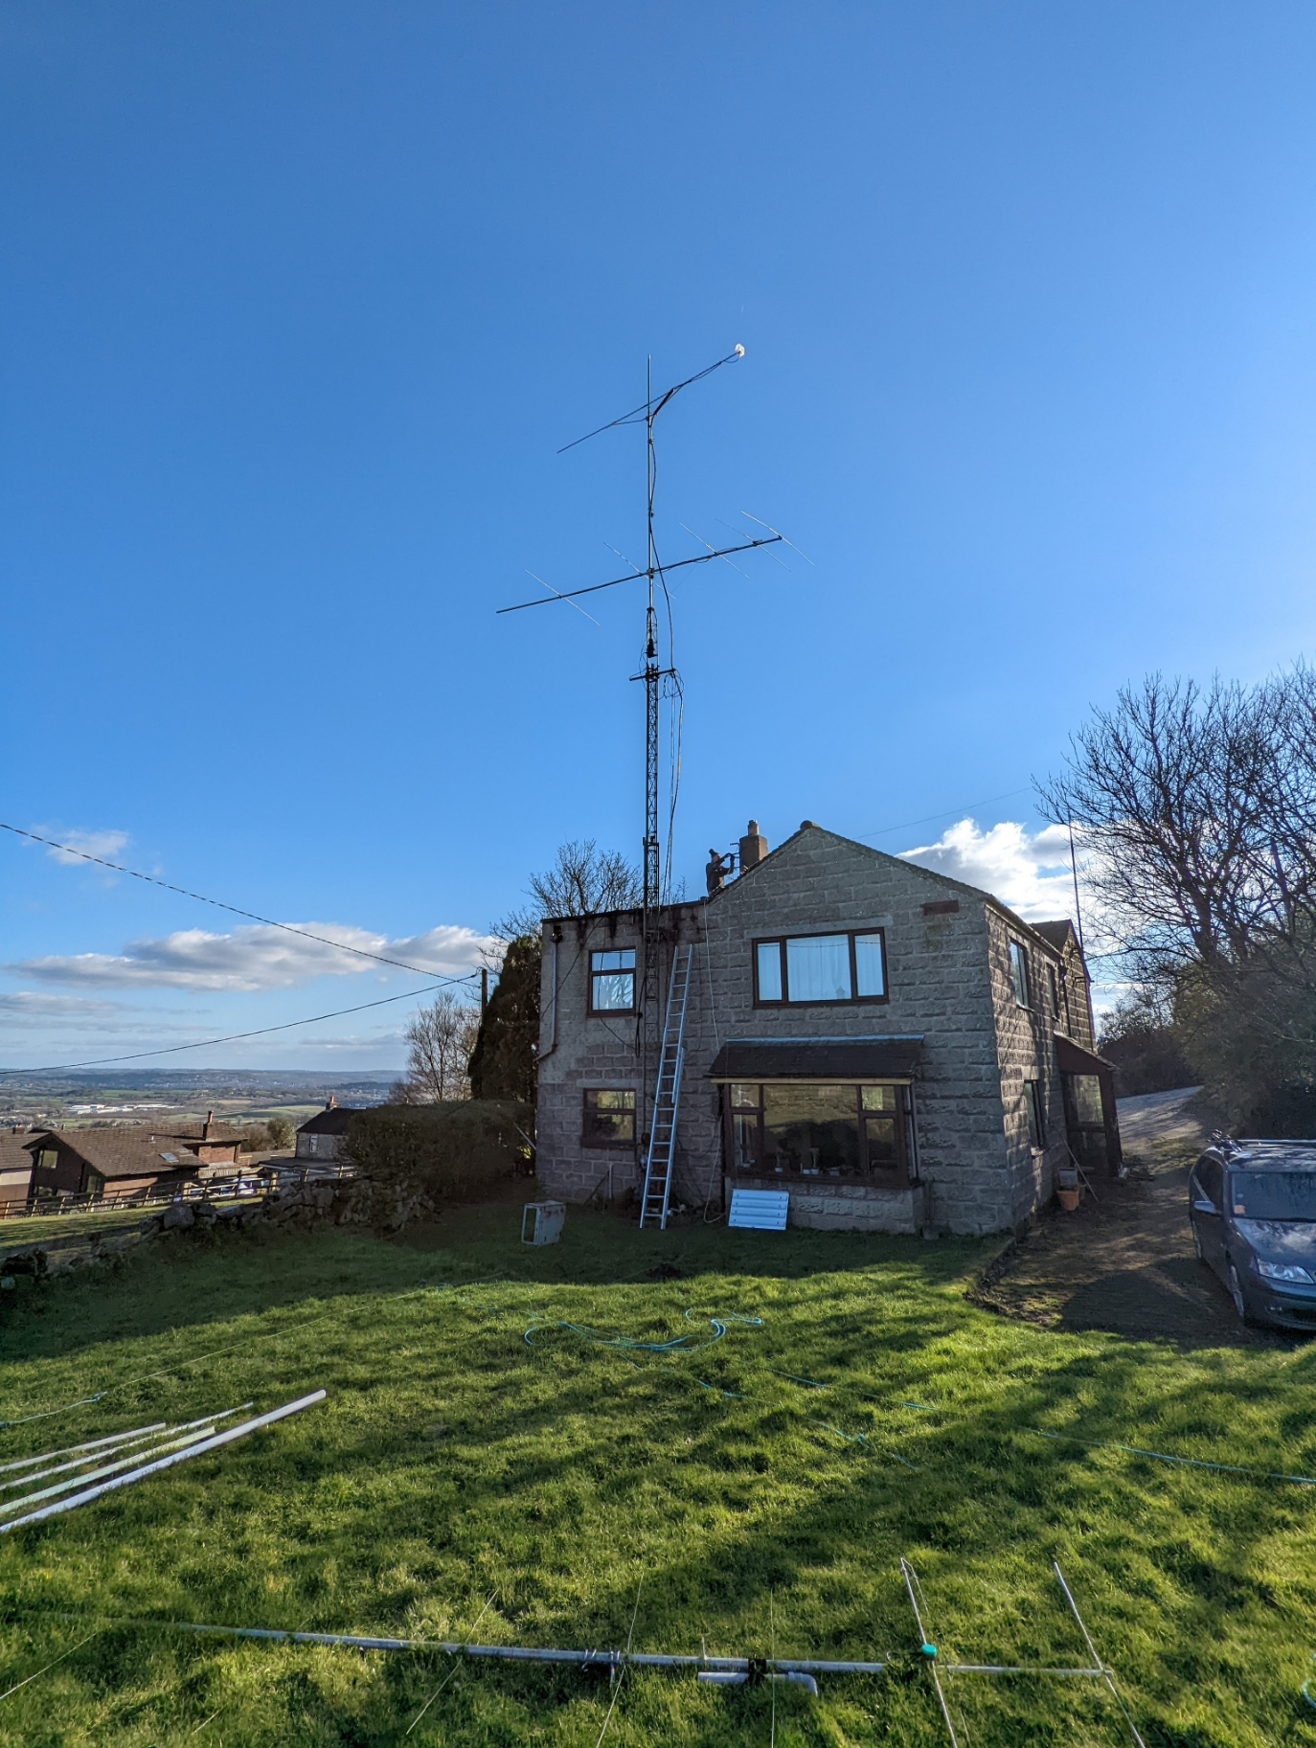
G3OHH Rotator Controller
Designed by G0CIT
Version 1
Basic instructions and design notes

Slide 2
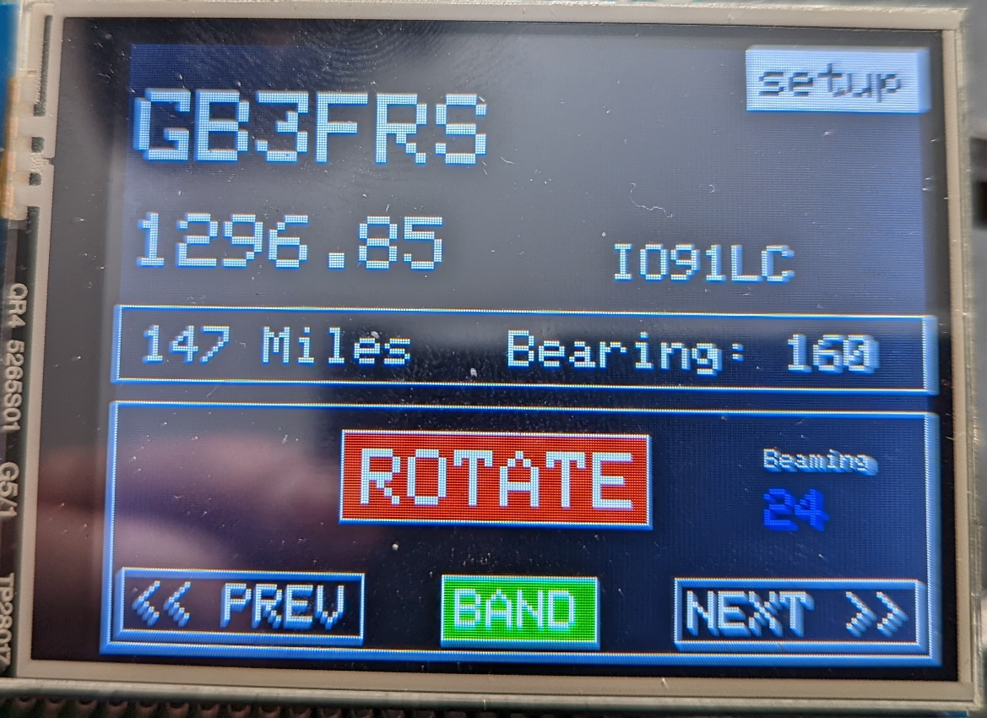
Normal Operations
Beacon information
Callsign, frequency, Locator
Bearing and distance calculated
From home station QRA
Currently set as IO83VC
Current Beam Heading
Scroll between beacons

Slide 3
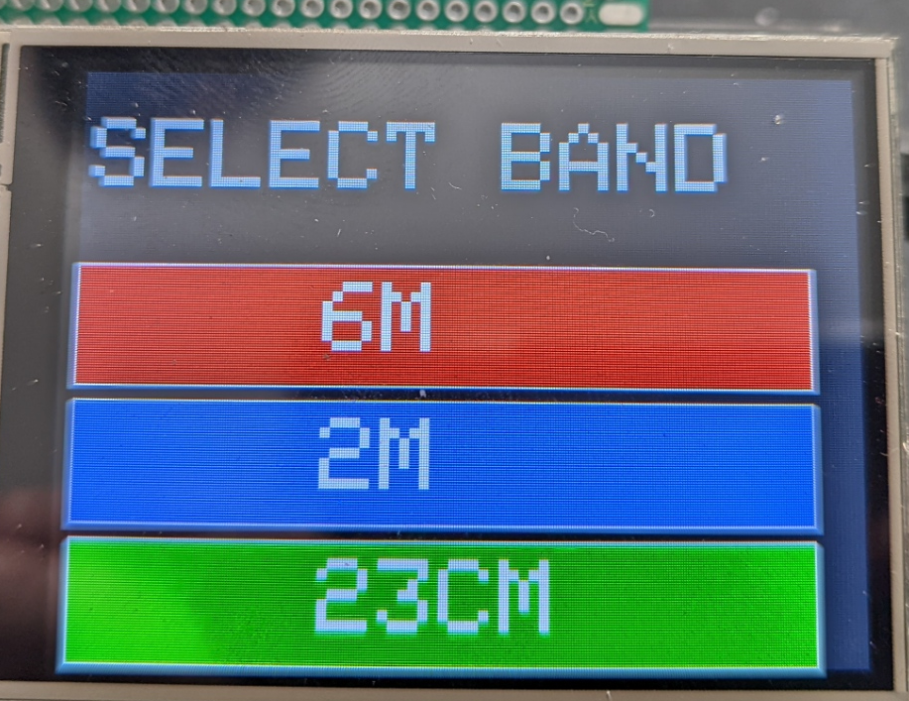
Changing Band
Press the band selection
Band will select the list of beacons available
After selection the interface will automatically return to
The operations screen

Slide 4
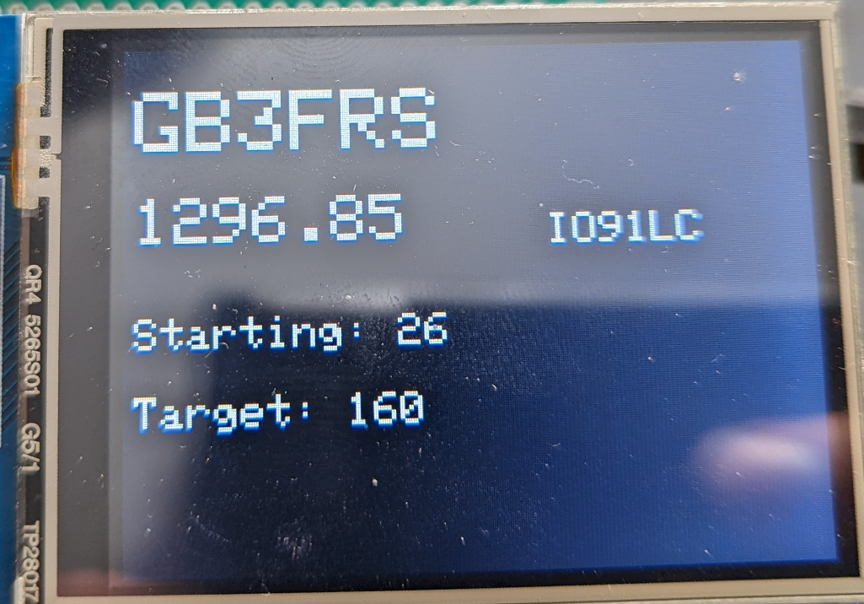
Initiating Rotation
Depending on the amount of direction change required the unit will follow this pattern
Start rotating slowly
Speed up for the middle part
Reduce speed as target approaches
Stop rotation
Pause
Remove backlash/overrun to compensate for inertia.
Press Rotate to re-position the
Antenna to the required Beacon
The screen will change to show the starting bearing
The target bearing and the name and frequency of th
Chosen beacon.
The screen will return upon completion of rotation.
(Known bug, if rotation is not possible this screen will not exit. Please restart the unit)

Slide 5
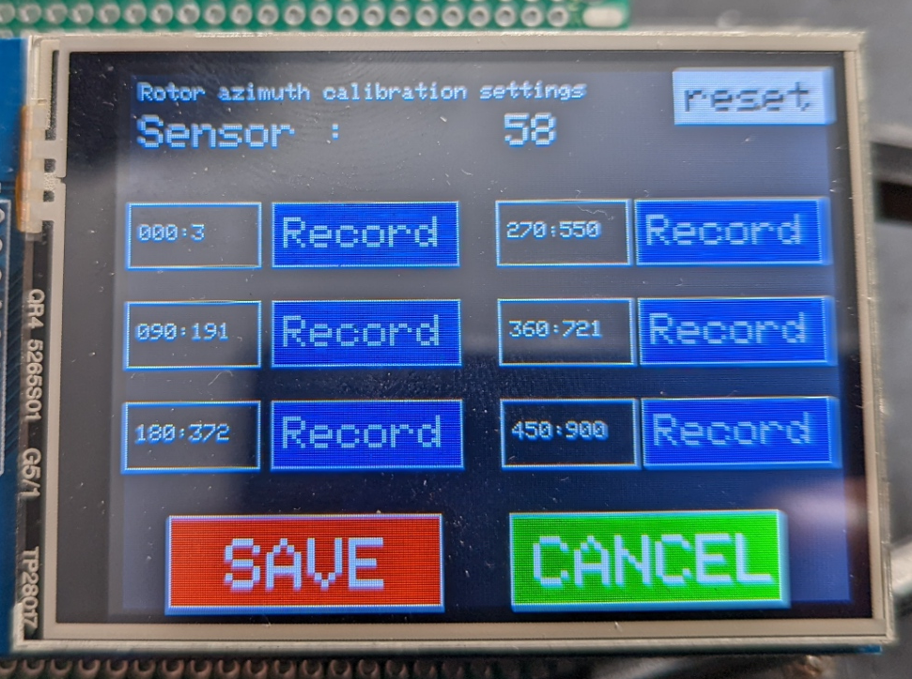
Calibration Sequence:
Position Antenna at 0 Degrees
Press the Record button to save the sensor setting as “zero”.
Position Antenna at 90 Degrees
Press the Record button for 90
Continue for 180,270, 360 and 450 degrees.
Press the “Save” button to record the defaults. Cancel discards the new calibration points and remain unchanged.
It is possible to set any number of points, it is not necessary to always do a full calibration.
Settings are saved to non-volatile memory.
Calibrating the unit
Press the set-up screen
0 Degrees
270 Degrees
90 Degrees
360 Degrees
180 Degrees
450 Degrees

Slide 6
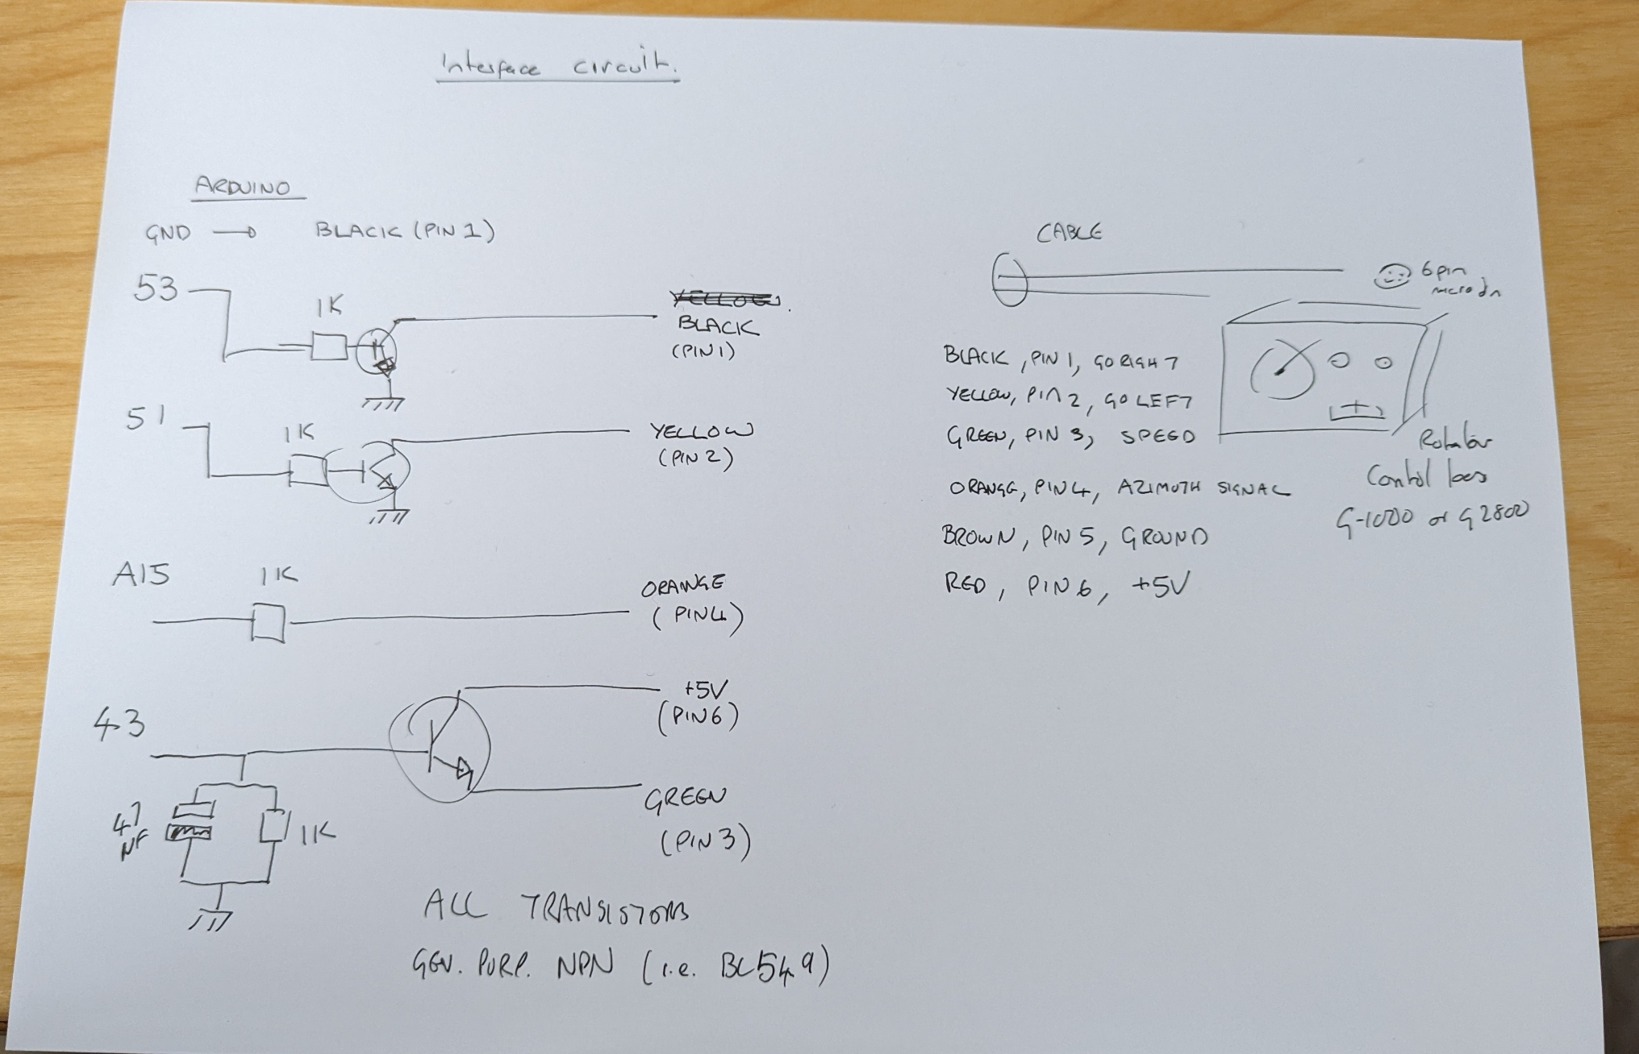

Slide 7
